Slide 1
Earthquake Preparedness
In Utah

Slide 2
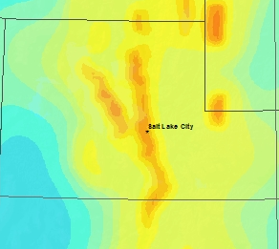
Wasatch Fault
Notes:
The Wasatch fault is called a normal fault, because the slip is mostly vertical - the mountain block (Wasatch Range)
moves upward relative to the adjacent downward-moving valley block. The 240-mile-long fault is sectioned
into 10 segments averaging 25 miles in length.

Slide 3
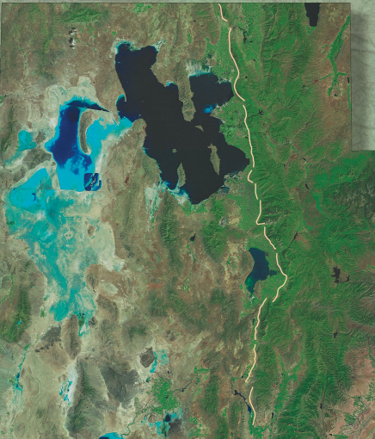
Notes:
Each segment can rupture independently. The Wasatch fault is one of the longest and most active normal faults in the world.
The Wasatch fault dips to the west under the valley. The strongest ground shaking occurs -out in the valley.

Slide 4
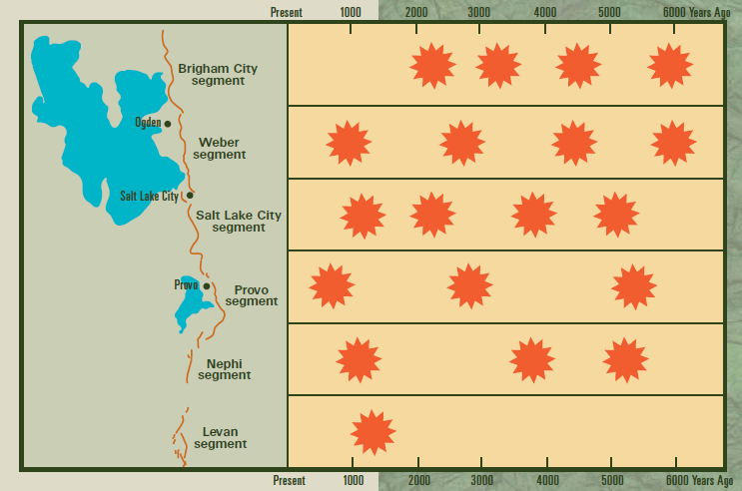
Notes:
Geologic studies show that at least 19 surface-faulting earthquakes (shown as starbursts on this generalized diagram) have
occurred on the Wasatch fault during the past 6,000 years.
These earthquakes took place on the fault's five central segments (Brigham City, Weber, Salt Lake City, Provo, and Nephi) and
one distal segment (Levan). Collectively, how often a large earthquake has occurred on the central portion of the Wasatch fault, is approximately once every 350 years. The last large earthquake happened about 600 years ago on the Provo segment. For any individual segment the "average recurrence interval" is longer - about every 1,200 to
2,600 years.

Slide 5
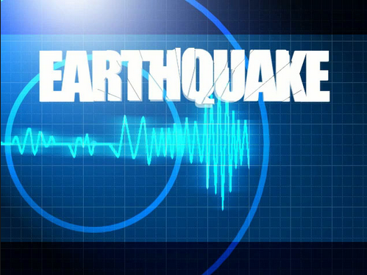
Notes:
Forecasts of future large earthquakes along the Wasatch fault are uncertain. Scientists do not know if Wasatch fault earthquakes occur in
regular cycles or if their timing is random. The next "big one"
may occur at any time. What is the probability of the "big one" happening on the Wasatch fault in our lifetime? Roughly 13 percent during the next 50 years.

Slide 6
The State
What systems are used to retrofit historic buildings.
How new buildings are built to withstand earthquakes
What is done for those caught in a collapse.

Slide 7
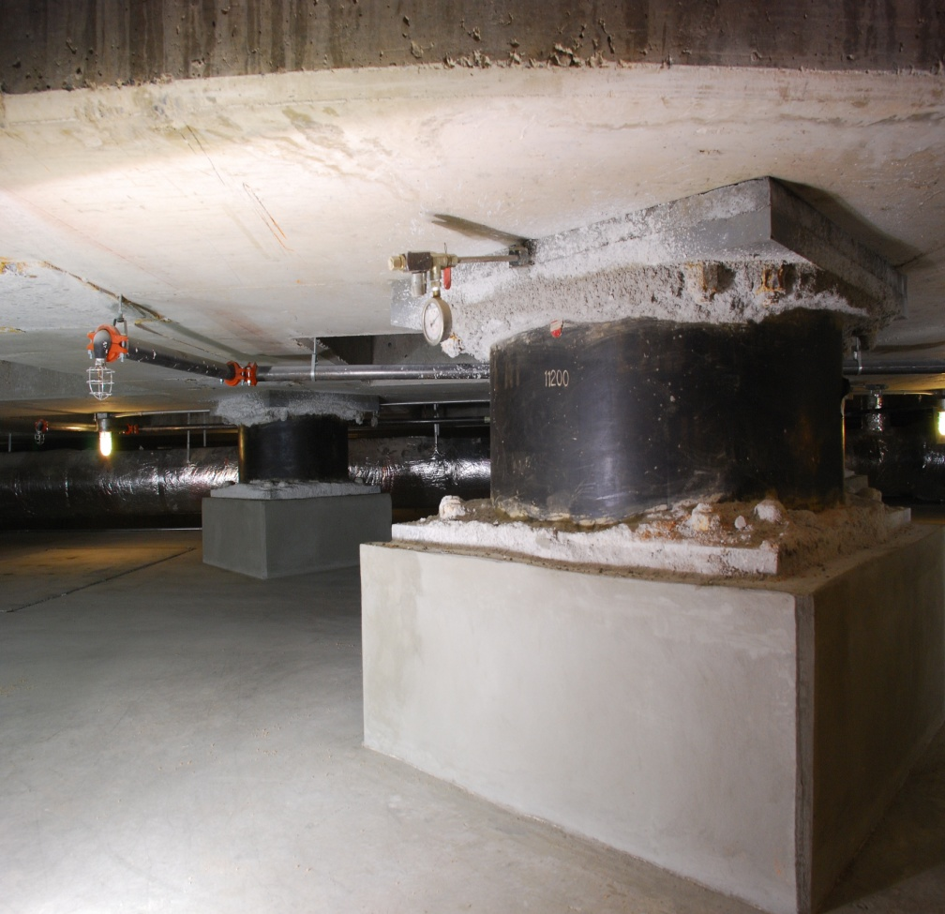
Base Isolation
Used in Seismic Retrofitting of the SL City And County Building, And The Capital Building
System Built in Foundation Piles Separates The Ground from the Building like a Shock Absorber in a car

Slide 8
Base Isolation Test
https://www.youtube.com/watch?v=kXadHl1_gmE#t=71

Slide 9
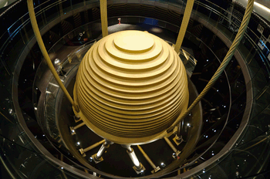
Mass Damper
For Lightweight 8+ Story Buildings
Used with modern construction of new buildings In Downtown SLC
Example: Is From Taipei 101 Largest Damper I The World

Slide 10
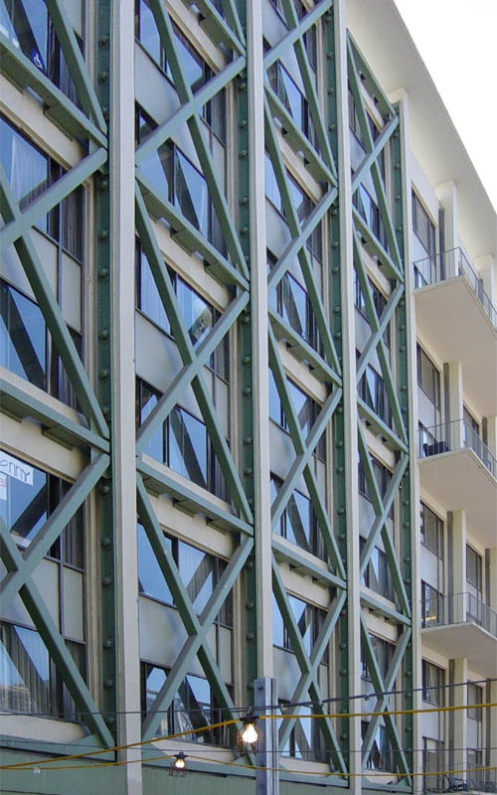
Cross-Bracing
External Retrofitting
Internally Built With structure
Cross Braces are built to Stiffen a frame of a building and to absorb energy.

Slide 11
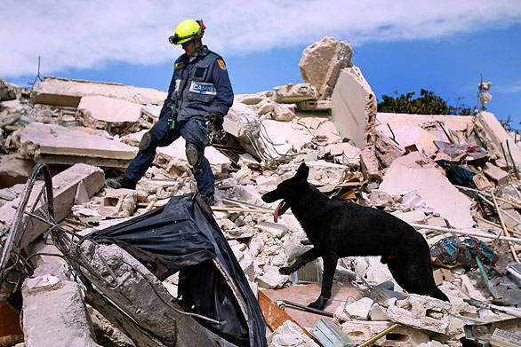
Search and Rescue
Urban rescue dogs are trained to find victims that have been trapped in a building that has collapsed

Slide 12
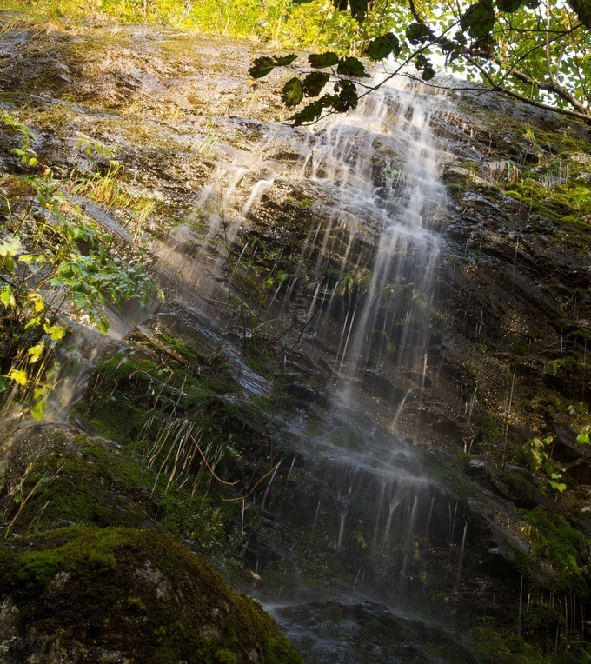
Time To Prepare!!!
By: Trisha Holt
And
Bradyn Musich

Slide 13
What would happen if a magnitude of 7.5 earthquake occurred along the Wasatch Fault?
- It could break segments of the fault about 20 - 40 miles long and produce movement at the surface of up to 10 - 20 feet.
- Strong ground shaking, could be felt up to 50 miles away
- Also possible are soil liquefaction, landslides, rock falls, and tilting of valley floors possibly causing the Great Salt Lake or Utah Lake to take over parts of Salt Lake City or Provo.
- Estimated damage would be around $4.5 billion in Davis, Salt Lake, Utah and Weber counties, and may only represent 20% of the economic loss.
- Surface faulting and ground failures due to shaking during a large earthquake will cause major disruption of lifelines (utilities, water, sewer), transportation systems (highways, bridges, airports, railways), and communication systems. This is why we should always be prepared, because it could be months until things are up and running again.
Notes:
What would happen if a magnitude of 7.5 earthquake occurred along the Wasatch Fault?
- It could break segments of the fault about 20 - 40 miles long and produce movement at the surface of up to 10 - 20 feet.
- Strong ground shaking, could be felt up to 50 miles away
- Also possible are soil liquefaction, landslides, rock falls, and tilting of valley floors possibly causing the Great Salt Lake or Utah Lake to take over parts of Salt Lake City or Provo.
- Estimated damage would be around $4.5 billion in Davis, Salt Lake, Utah and Weber counties, and may only represent 20% of the economic loss.
- Surface faulting and ground failures due to shaking during a large earthquake will cause major disruption of lifelines (utilities, water, sewer), transportation systems (highways, bridges, airports, railways), and communication systems. This is why we should always be prepared, because it could be months until things are up and running again.

Slide 14
Things to do before and after an Earthquake!
1. Preparing your family for an Earthquake
2. Tips for preparing children
3. Tips for pet owners
4. How to secure items in the home.
5. Organizing your neighborhood
6. What to do during an earthquake.
7. What to do after an earthquake
Notes:
Things to do to prepare!
-Preparing your family for an Earthquake
- Tips for preparing children
- Tips for pet owners
- How to secure items in the home.
- Organizing your neighborhood
- What to do during an earthquake.
- What to do after an earthquake.

Slide 15
Tips for preparing Infants and Toddlers!
* Cribs should be placed away from windows and tall, unsecured bookcases and shelves that could slide or topple over
*A minimum of a 72 hr supply of extra water, formula, bottles, food ,juices, clothings, disposable diapers, baby wipes and medications should be stored where accessible to grab if an earthquake happens. Also have an extra diaper bag.
*Install bumper pads in cribs to protect babies during the shaking
* Install latches on all cupboards ( not just those young children can reach) so nothing can fall on your baby during the quake.
* Store strollers, wagons, blankets, and cribs with appropriate wheels to evacuate infants if necessary.

Slide 16
Tips for Preparing Children
* By the age of 3, children can understand what an earthquake is and how to get ready for one.
* Show children the safest places to be in each room when an earthquake hits, also show them all the possible exits.
* Use sturdy tables to teach children to Duck, Cover, and Hold
* Make sure children’s Emergency cards at school are up to date.
* Teach children what to do where ever they are during an earthquake ( at school, in a tall building, outdoors, etc.)
* Although children should not turn off any utility valves, it’s important that they know what gas smells like. Advise children to tell an adult if they smell gas after an earthquake.

Slide 17
Tips for Pet Owners
* Store enough food and water to last 72 hrs., preferably one week. Prepare a shelter or evacuation kit for your pet, including unbreakable dish, veterinarian records, a restraint ( leash or pet carrier) and medication with instructions.
* Keep your pet’s ID tags up-to-date
*Arrange for a neighbor to take care of your pet if you are not able to get home after the earthquake.
* During the quake do not try to hold your pet, animals will instinctively protect themselves and hide where they’re safe. If you get in their way, even the nicest pets can turn on you.
* Be patient with your pets after the quake. They get stressed just like people and need time to readjust.
*If you have outdoor pets, you should keep them indoors until the aftershocks have subsided.
*If you must evacuate your home, leave your pet secured in a safe place. Pets will not be allowed at shelters. Be sure to leave plenty of clean water and food. If possible visit pet daily until you can return home.

Slide 18
Organizing your Neighborhood
* Inventory your neighbor’s skills, and what they have that could be useful in a disaster. Find out who have medical, electrical, child-care leadership, firefighting and survival skills. Find out who has generators or camping trailers, who own chain saws, citizen band radios, four wheel drive vehicles, motorcycles and water purifiers. etc. Finding out as much about your neighbors will help in an emergency because you can all work together
* Learn basic search-and-rescue skills
*Learn simple firefighting techniques
* Learn to assess yourself, your family and coworkers for injuries
* Learn to assess your home and workplace for hazards or damage.
* Learn to assess your community fir hazards, needs and available resources.
*They recommend inventorying your neighborhood yearly and have some place to have everyone meet in a disaster, so you can work together to help the others.

Slide 19
Other items the neighborhood should have:
* Gloves and goggles
* adjustable wenches
* hard hats and vest
* Flashlights with extra batteries
* axes and crowbars
* ropes
* Have these items in a central location so anyone can get to them in case of emergency.

Slide 20
How to secure Your Furniture
* TV’s, Stereos, computers, lamps and chinaware can be secured with buckles and safety straps attached to the table top. ( which allows for easy movement of the units when needed) or with hook and loop fasteners glued to both the table and the unit.
* Glass and pottery objects can be secured with nondrying putty or microcrystalline wax.
Securing Items in your Kitchen
* Use child-proof latches, hook and eye latches or positive catch latches, designed for boats, to secure your cabinet doors
* Make sure your gas appliances have flexible connectors to reduce the risk of fire.
* Secure your refrigerator to prevent movement

Slide 21
Securing your Furniture part 2
* Secure the tops of all top-heavy furniture such as bookcases and file cabinets to the wall. Be sure to anchor to the stud. Flexible fasteners such as nylon straps allow tall objects to sway without falling over, reducing the strain on the stud.
* Replace your windows with ones made from safety glass or cover them with a strong shatter-resistant film. Be sure to use safety film and not just solar film.
* Ceiling lights and fans should be additionally supported with a cable bolted to the ceiling joist. The cable should have enough slack to allow it to sway.
* Framed pictures, should be hung from closed hooks so that they can’t bounce off. Only soft art such as tapestries should be placed over beds and sofas.

Slide 22
Personal Preparation prior to an earthquake!
Build an emergency kit & have a family communication plan.
Fasten shelves & heavy items such as mirrors or large pictures to walls & away from couches & places that people sit.
Seek professional help to repair faulty wiring connections and leaking gas connections. – Install flexible pipe fittings.
Secure your water heater, refrigerator, furnace and gas appliances by strapping them to the wall studs and bolting to the floor.
Practice earthquake drills with family members. Drop, cover, and hold on.

Slide 23
Earthquake Insurance
Primary factors that are considered and weighed when developing rates are: the environment, historical results, building construction, etc.
There are two approaches to earthquake rating. One divides the state into geological territories that generally follow the zones assigned by the U.S. Geological Survey. The second establishes one statewide rate. It varies by insurance company.
The deductible is an important part of the insurance. It is a percentage of the amount of insurance, or limit of liability, rather than a percentage of the amount of the loss. For example, a 10% deductible on a $100,000 policy would be $10,000 whether the loss was $5,000 or $100,000.
One reason for the high deductible is that insurers cannot spread earthquake risks across the nation, or even across an individual state, as they spread fire and other property risks. This is also the reason for high premiums.

Slide 24
Insurance Continued
Another unique element of earthquake insurance is that most insurers require a waiting period, usually from 10 to 30 days, before they will bind coverage for a new applicant.
Most insurers place a moratorium on writing new earthquake coverage when there has been a recent earthquake in the location in question.
If there has been a recent earthquake people rush to buy insurance and it is not beneficial for the insurance companies.

Slide 25
What To Do During An Earthquake
If indoors, DROP to the ground and take COVER by getting under a sturdy table or other piece of furniture; and HOLD ON until the shaking stops.
Do not use a doorway (except if you know it is a strongly supported).
Stay inside until the shaking stops.
If outdoors, Stay there.
Move away from buildings, streetlights, and utility wires.
Once in the open, stay there until the shaking stops. The greatest danger exists directly outside buildings, at exits and alongside exterior walls
If in a moving vehicle, stop as quickly as safety permits and stay in the vehicle. Avoid stopping near or under buildings, trees, overpasses, and utility wires.

Slide 26
What To Do After An Earthquake
Expect aftershocks. These secondary shockwaves are usually less violent than the main quake but can be strong enough to do additional damage.
Help injured or trapped persons.
Look for and extinguish small fires. Fire is the most common hazard after an earthquake.
Inspect utilities.
Listen to a battery-operated radio or television for the latest emergency information.

Slide 27
Now that an Earthquake has happened what is
Salt Lake County
Prepared to Do?
“The mission of Salt Lake County Emergency Management is to establish, coordinate, maintain county-wide emergency management activities and intergovernmental, private, and volunteer partnerships in order to establish sustainable communities and support responses to and recovery from emergencies, as well as collect and disseminate critical information.”

Slide 28
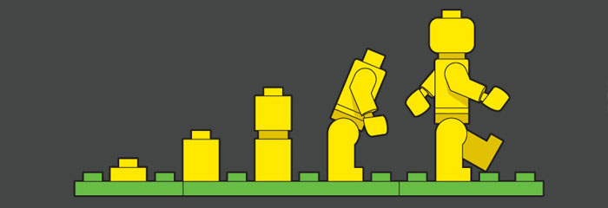
Salt Lake County Emergency Operation Plan:
Notes:
Bottom-Up Approach-
Local Efforts to County Efforts then to State Efforts then to Federal Government
Each Level has to be exhausted before reaching help to the next level-

Slide 29
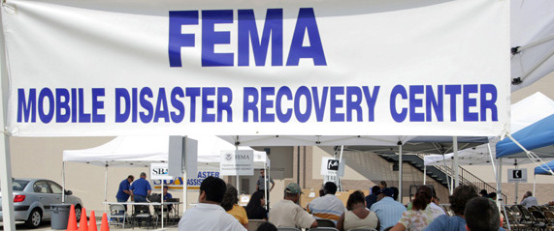
Notes:
Requesting State and Federal Resources
Requests for assistance will be forwarded to the state Division of Emergency Management from the county when local resources are exhausted or local capabilities are unable to meet the need. Division of Emergency Management can orchestrate and bring to bear outside resources and materials to meet the situation. The State of Utah is able to contact the federal government for assistance if it is unable to fill the request.

Slide 30
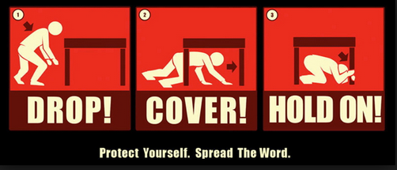
Notes:
The coordination center for any emergency operations will be 3380 S 900 W, SLC.
The Mayor has the authority to declare an Local State of Emergency at any time. After 30 days from the declaration it will expire unless ratified by the County Council. –
The Mayor may determine, after consulting with local government officials that the recovery appears to be beyond the combined resources of both the county and local governments and that state assistance may be needed. The Mayor must certify that the severity and magnitude of the disaster exceed county and local capabilities; certify that state assistance is necessary to supplement the efforts and available resources of the county and local governments, If the county receives a presidential disaster declaration, a recovery team will be implemented to address long-term issues in recovery.

Slide 31
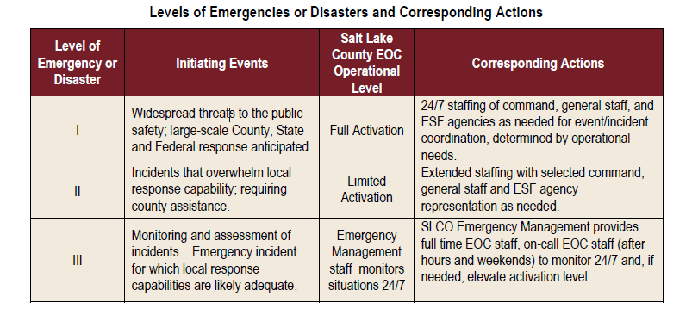

Slide 32
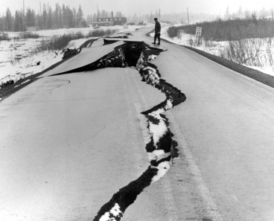
Notes:
SLC Hazard Analysis of an earthquake-
Medium- Occurrence frequency between 1 and 25 years- Localized damage may be severe, Warning lead time may be minutes. Population and area at risk is county wide. Handled with community resources and mutual aid.

Slide 33
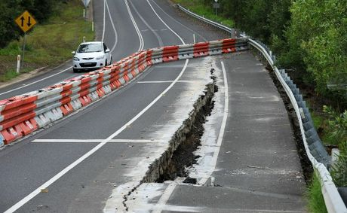
Notes:
Chance of a Earthquake in the Wasatch Front Region during the next 50 years is a 1 in 4. Earthquake-related hazards may include ground shaking, soil liquefaction, surface fault rupture, tectonic subsidence, slope failure, and problems related to changes in ground water.

Slide 34
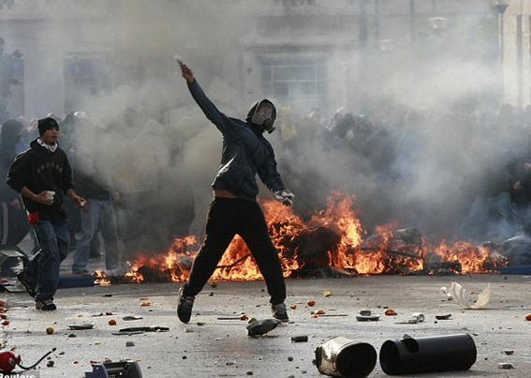
Notes:
Continuity of Government
Continuity of government is an essential function of emergency management and is vital during
a community emergency/disaster situation. All levels of government (federal, state, and local)
share a constitutional responsibility to preserve life and property of its citizenry. Local
continuity of government is defined as the preservation and maintenance of the local civil
government ability to carry out its constitutional responsibilities.

Slide 35
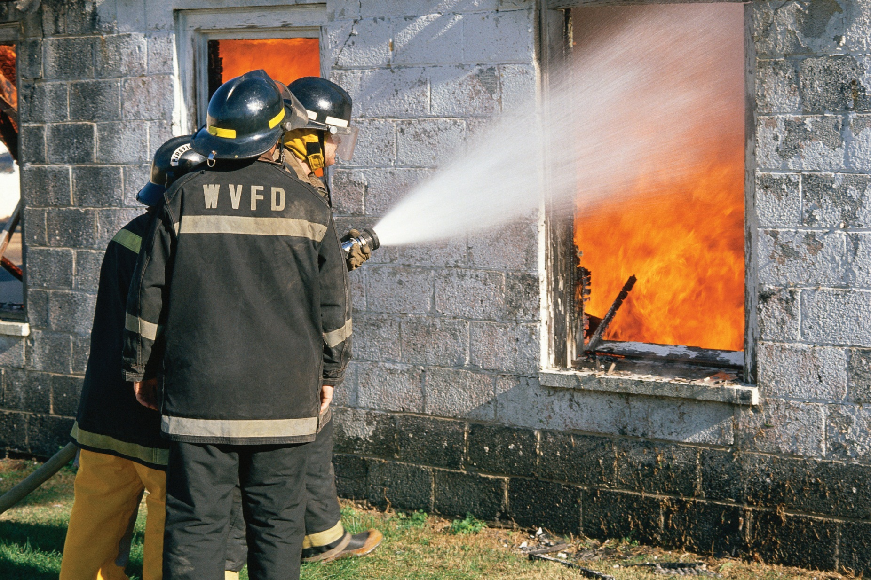
Notes:
Damages will not only be Physical but also Economical
Plan up to 72 hours and even up to 2 weeks

Slide 36

Notes:
Priorities of response will focus on life safety; then basic survival issues (water, food, basic medical care, shelter); restoration of community’s vital infrastructures (water/waste systems, electric, phones, roads); cleanup and emergency repairs; and then recovery.

